Slide 1
Introduction to Information System
CT026-3-1-Systems Analysis and Design

Slide 2
Topic Learning Outcomes
At the end of this topic, you should be able to:
1. Define system
2. List and describe with examples components of an Information
3. Identify various types of information systems system
4. Understand the current trends in IS Projects

Slide 3
Contents & Structure
Definition of a system
Components of an Information System
Types of Information System
Current Trends in IS Projects

Slide 4
Recap From Last Lesson
None

Slide 5
Key terms you must be able to use
If you have mastered this topic, you should be able to use the following terms correctly in your assignments and exams:
System
Hardware
Software
Data
Processes
people

Slide 6
What is system?
Set of related components that produces specific results
Businesses use many types of systems

Slide 7
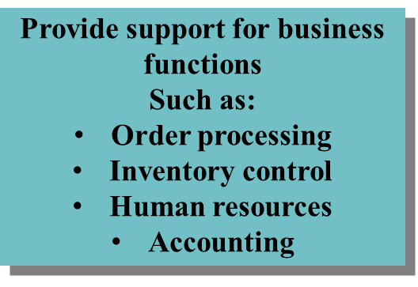


Systems

Slide 8
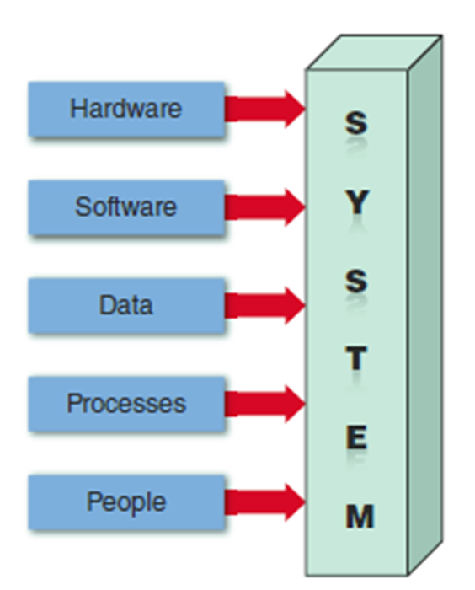
Components of Information Systems
Hardware
Software
Data
Processes
People

Slide 9

Components of Information Systems
Hardware
Is the physical layer of the information system
Can include :
Servers
Workstations
Networks
Scanners
Digital capture devices
Telecommunications equipment
Fiber-optic cables
Mobile devices
Figure 1 : Server farms provide the enormous power and speed that modern IT system need.

Slide 10



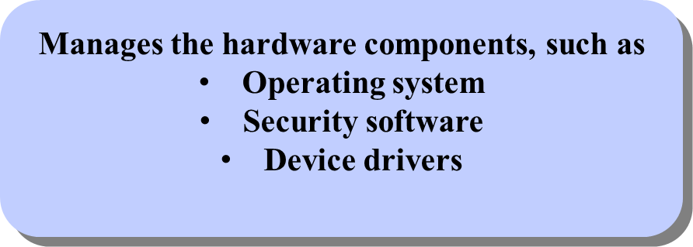
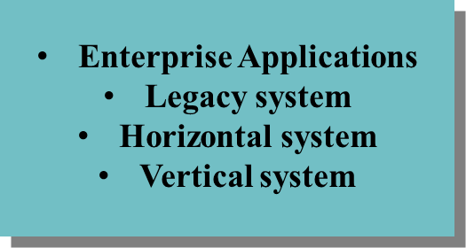
Components of Information Systems
Software
Programs that control the hardware and produce the desired information or results
Consists of:

Slide 11

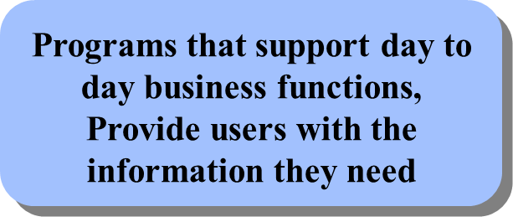

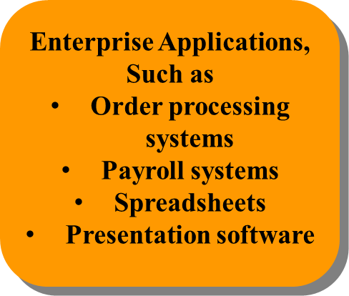
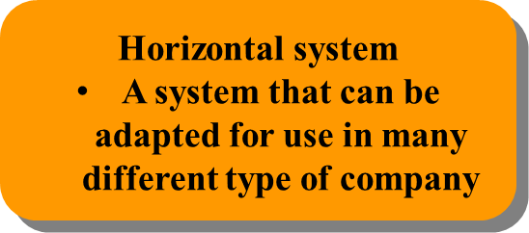
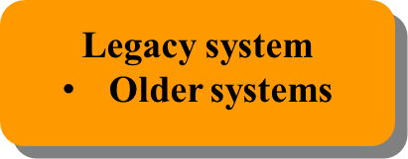
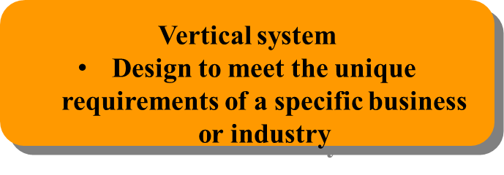
Components of Information Systems

Slide 12
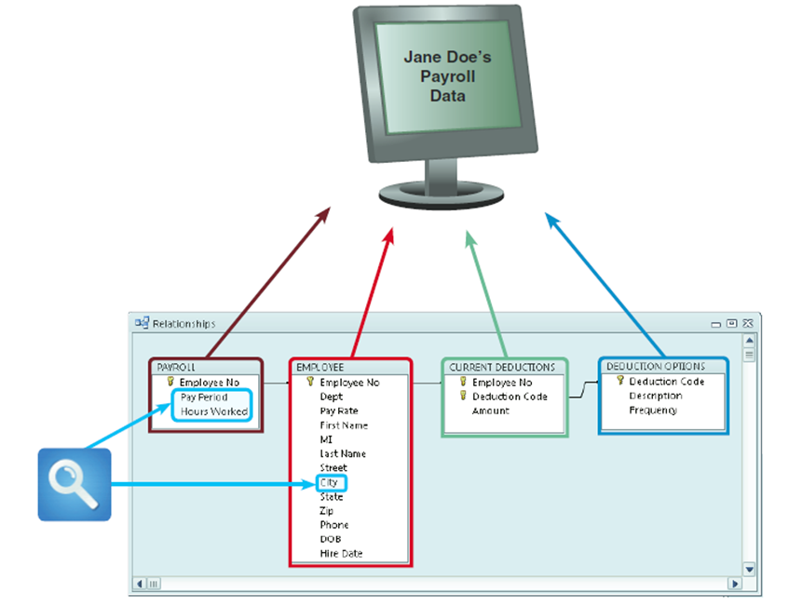
Components of Information Systems
Data
Data is raw facts that an IS transforms into useful information
Data has no inherent meaning
Data cannot be used for making decision
Figure 2 : In a typical payroll system, data is stored in
separate tables that are linked to form an overall databased.

Slide 13
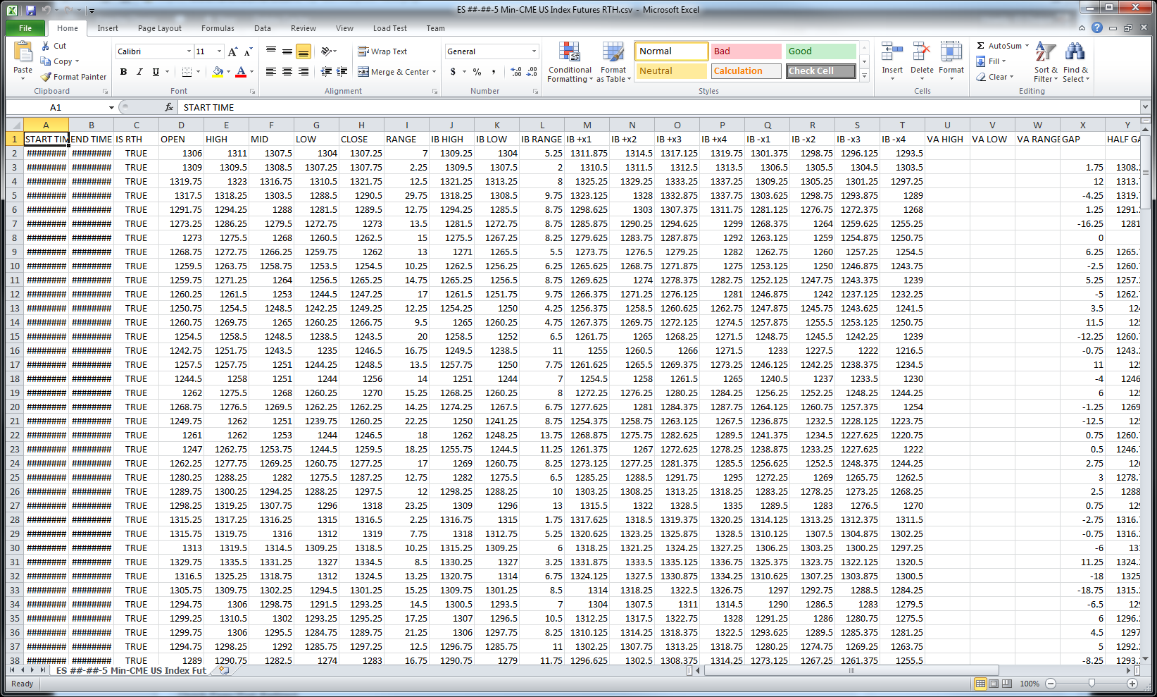
Data

Slide 14
Components of Information Systems
Processes
Describe the tasks and business functions that users, managers, and IT staff members perform to achieve specific results
Represent actual day-today business operations
Example : Generate report

Slide 15
Components of Information Systems
People
Have an interest in an IS
A user is a person who communicates with an IS or uses the information that it generates
Example : Stakeholders

Slide 16
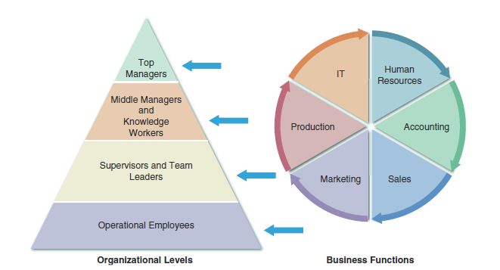
Importance of IS in Organisation
Figure 3 : A typical organizational model identifies business functions and organizational levels.

Slide 17
Types of Information Systems
Classified by organisational levels, mode of data, processing, system objectives and type of support provided.
Enterprise computing systems
Transaction processing systems
Business support systems
Knowledge management systems
User productivity systems

Slide 18
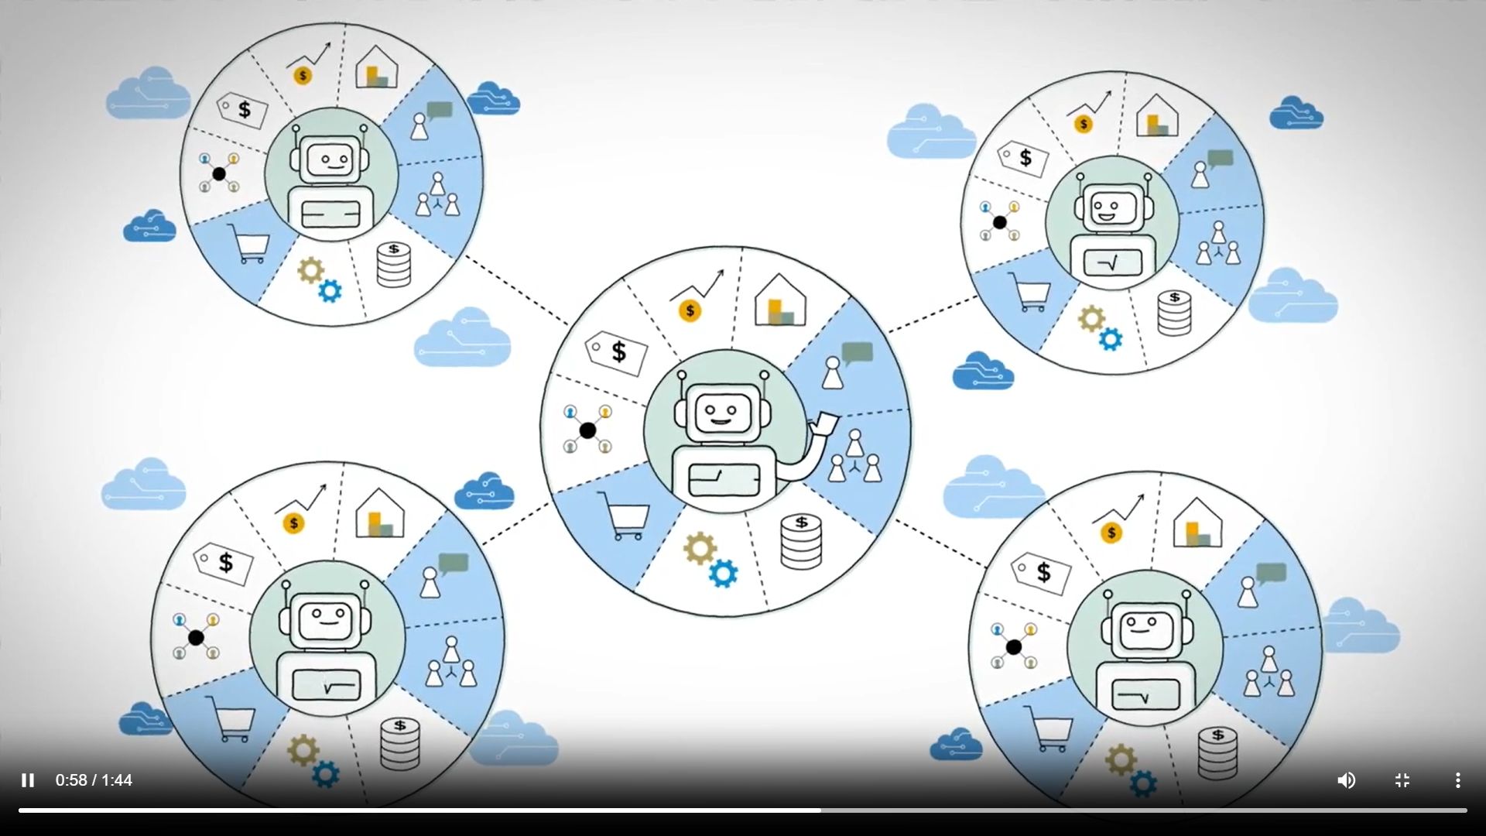
Types of Information Systems
Enterprise computing systems
Support company-wide operations and data management requirements
Enterprise resource planning (ERP)
Many hardware and software vendors target the enterprise computing market
Figure 4 : ERP helps to efficiently manage all these processes in an integrated system (Source: https://www.sap.com/sea/products/erp/what-is-erp.html)

Slide 19
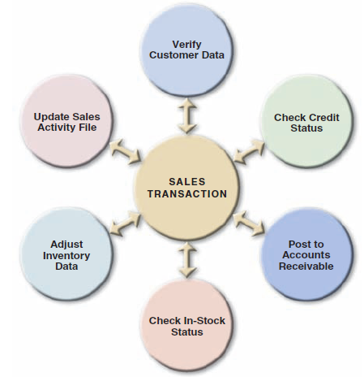
Types of Information Systems
Transaction processing systems
Involve large amounts of data and are mission-critical systems
To provide transaction in order to update records and generate reports i.e to perform store keeping function
Such as bill system, payroll system, stock control system.

Slide 20
Types of Information Systems
Business support systems
Designed to take relatively raw data available through a Transaction Processing System and convert them into a summarized and aggregated form for the manager, usually in a report format.
Management information systems (MIS)
Such as Sales management systems, Human resource management system.

Slide 21
Types of Information Systems
Knowledge management systems
Called expert systems
Simulate human reasoning by combining a knowledge base and inference rules
Many knowledge management systems use a technique called fuzzy logic

Slide 22
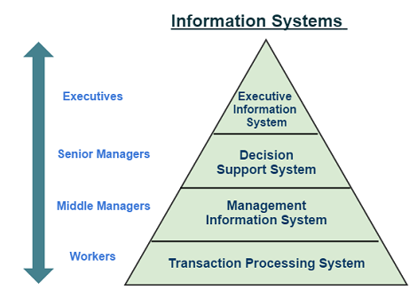
Types of Information Systems
Figure 5 : https://www.assignmenthelp.net/assignment_help/what-is-information-systems-and-types

Slide 23
Types of Information Systems
User productivity systems
A category of software applications and tools that are designed to enhance the productivity and efficiency of individual users, such as employees within an organization.
Intended to help users perform their tasks more effectively, manage their time efficiently, and collaborate with others seamlessly.
Groupware: Calendar, Email and Scheduling Software

Slide 24
Current Trends in IS Projects
Structured Analysis
The SDLC model usually includes five steps :
Systems planning
Systems analysis
Systems design
Systems implementation
Systems support and security

Slide 25
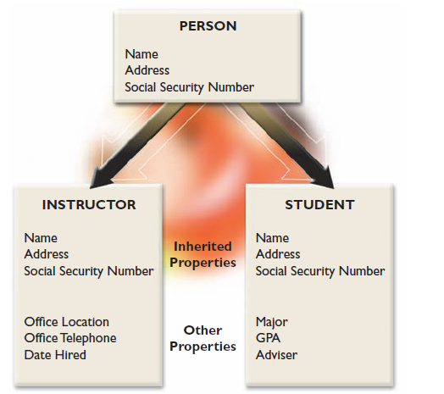
Current Trends in IS Projects
Object-oriented Analysis
Combines data & processes that act on the data into things called objects
Object is a member of a class
Objects possess properties
Methods change an object’s properties
A message requests specific behavior or information from another object
Usually follow a series of analysis and design phases that are similar to the SDLC
Interactive model

Slide 26
Current Trends in IS Projects
Agile Methods
Are the newest development
Emphasize continuous feedback
Iterative development
Agile community has published the Agile Manifesto
Spiral model

Slide 27
Current Trends in IS Projects
Agile Methods
Agile process determines the end result
Other adaptive variations and related methods exist
Two examples are Scrum and Extreme Programming (XP)
Analysts should understand the pros and cons of any approach before selecting a development method

Slide 28
Current Trends in IS Projects
Other Development Methods
Joint application development (JAD)
Rapid application development (RAD)
Rational Unified Process (RUP)
V model
DevOps model

Slide 29
Review Questions
What are the components of the system and give example for each ?
List types of Information System.

Slide 30
Summary
Definition of a system
Components of an Information System
Types of Information System
Current Trends in IS Projects

Slide 31
What To Expect Next Week
In Class
Preparation for Class
Systems Analyst and Project Manager
The skills and roles
Project management issues
Download the slide and study for the next chapter.

